Slide 1
SQL injection & Prevention

Slide 2
AGENDA
Introduction to SQL Injection
SQL injection is a type of cyberattack that targets the security vulnerabilities in a web application's database layer. It involves exploiting weaknesses in the way an application handles user-inputted data, particularly when interacting with a database using SQL (Structured Query Language). SQL injection attacks can have severe consequences, including unauthorized access to sensitive data, data manipulation, and even unauthorized control of the application or database.
Understanding SQL Injection Attacks
Classic SQL Injection: Attackers inject malicious SQL statements into the application's input fields.
Blind SQL Injection: Attackers exploit vulnerabilities without receiving direct error messages, making it harder to detect.
Time-Based Blind SQL Injection: Attackers delay server responses to infer information indirectly.
Second-Order SQL Injection: Payload is stored and executed later when certain conditions are met.

Slide 3
Identifying SQL injection Vulnerabilities
SQL injection vulnerabilities are security weaknesses in web applications that allow attackers to manipulate user input in a way that can lead to unauthorized access to a database or unauthorized manipulation of data within the database. These vulnerabilities occur when applications do not properly validate, sanitize, or parameterize user input before using it in SQL queries.
Prevention Technique for SQL Injection
Preventing SQL injection is a critical aspect of securing web applications and databases. Implementing effective prevention techniques can help safeguard your application against this type of vulnerability. Here are some key techniques and best practices for preventing SQL injection:
Use Parameterized Queries or Prepared Statements
Input Validation
Escaping User Input
Least Privilege Principle

Slide 4
Problems With SQL Injection
Unauthorized data access
Unauthorized data access refers to the unauthorized or illegitimate access, retrieval, or viewing of data, information, or resources by individuals or entities who do not have the appropriate permissions or privileges to do so. This type of access can occur in various contexts, including computer systems, databases, networks, and physical facilities. Unauthorized data access is a significant security concern, as it can lead to data breaches, privacy violations, financial losses, and other adverse consequences.
Data manipulation
Data manipulation refers to the process of altering, modifying, or changing data to meet specific requirements, objectives, or to extract useful information. It is a fundamental operation in various fields, including database management, data analysis, and software development. Data manipulation can take many forms, depending on the context and goals, and it often involves actions such as filtering, transforming, aggregating, and combining data.

Slide 5
Remote code Execution
Remote Code Execution (RCE) is a severe security vulnerability and a type of cyberattack where an attacker can execute arbitrary code on a target system or application from a remote location. This type of attack can have devastating consequences, as it allows the attacker to gain unauthorized control over the compromised system, potentially leading to data breaches, system compromise, and other malicious activities
Denial of Service
Denial of Service (DoS) is a type of cyberattack aimed at disrupting the normal functioning of a target system, network, service, or application by overwhelming it with a flood of traffic, requests, or malicious actions. The goal of a DoS attack is to render the target inaccessible or significantly degrade its performance, thereby denying legitimate users access to the resources or services it provides.
Malware Injection
Malware injection refers to the process of introducing malicious software, commonly known as malware, into a target system, network, or application with the intent to compromise its security, steal data, or gain unauthorized access. Malware injection can take various forms and is a prevalent method used by cybercriminals to exploit vulnerabilities and compromise the integrity and confidentiality of systems and data.

Slide 6
Preventing SQL Injection
Input validation and Sanitization
Input validation and sanitization are crucial security measures employed in software development to ensure that user-provided data is safe, clean, and free from malicious content before it is processed or stored. These practices help prevent a wide range of security vulnerabilities, including code injection attacks, data breaches, and other security threats.
Least privilege principle
The least privilege principle is a fundamental concept in computer security and access control that states that individuals, systems, or processes should be granted only the minimum level of access or permissions necessary to perform their legitimate tasks or functions. In other words, individuals or entities should have the least amount of privilege required to complete their work, and no more. This principle helps reduce the attack surface and limit the potential damage that can occur in the event of a security breach.

Slide 7
Regular Updates and patches
Regular updates and patches are crucial components of effective cybersecurity practices. They involve keeping software, operating systems, applications, and hardware up to date with the latest security fixes and improvements provided by the software vendors and manufacturers. Regularly applying updates and patches helps protect systems and networks from known vulnerabilities and security threats.
Web application Firewalls
A Web Application Firewall (WAF) is a security solution designed to protect web applications, websites, and web services from various online threats, including common web application attacks and vulnerabilities. WAFs work as an additional layer of defense between web users and web servers, helping to filter and monitor incoming and outgoing traffic to detect and block malicious activity.

Slide 8
Project Overview
If the login application does not perform correct input validation of the form fields, the attacker can inject strings into the query that alter its semantics.
EX: consider a hacker entering “OR 1=1” -- one of SQL injection string as in the table(1), the “--” command indicates a comment in Transact-SQL. Hence, everything after the first “--” is ignored by the SQL database engine with the help of the first quote in the input string, the user’s name string is closed, while the “OR 1=1” adds a clause to the query which evaluates to true for every row in the table. When executing this query, the database returns all user rows, which applications often interpret as a valid login. So, in the proposed system all client-supplied data needs to be cleansed of any characters or strings that could possibly be used maliciously.

Slide 9
Project Requirements:
HTML
CSS
BOOTSTRAP
PHP
SQL
Windows 10 or higher
XAMPP Apache tomcat server
MySQL database

Slide 10
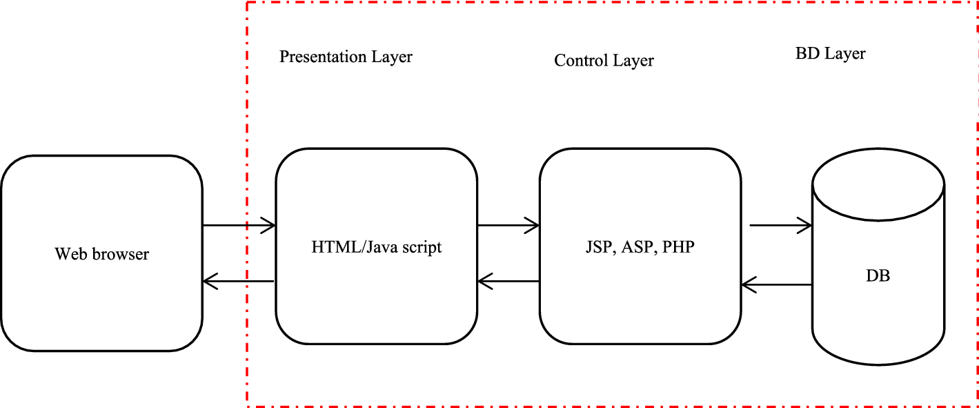
Project Architecture

Slide 11
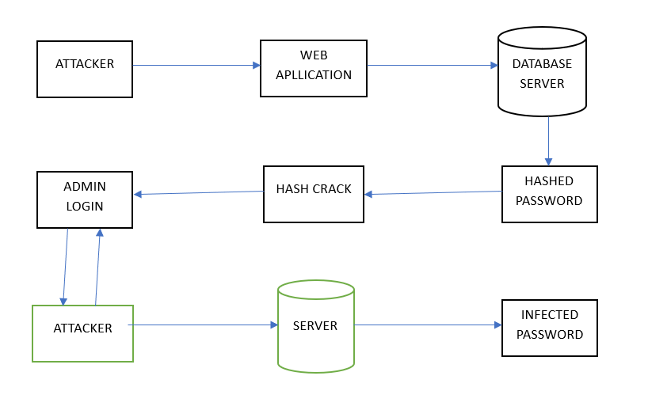

Slide 12
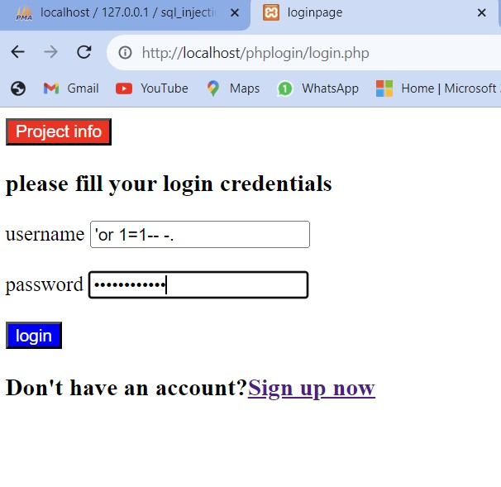
RESULTS AFTER SQL INJECTION ATTACK

Slide 13
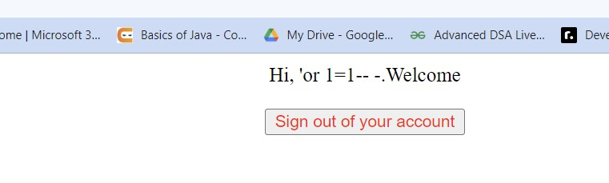
RESULTS AFTER SQL INJECTION ATTACK
WELCOME PAGE:

Slide 14
RESULTS AFTER SQL INJECTION PREVENTION
LOGIN PAGE:

Slide 15

RESULTS AFTER SQL INJECTION PREVENTION
LOGIN PAGE:

Slide 16
Who Are The End Users
Developers
Developers are professionals who specialize in writing, designing, and maintaining software applications, websites, and computer programs. They play a pivotal role in the field of information technology (IT) and are responsible for creating the software solutions that power the digital world.
Database Administrators
Database Administrators (DBAs) are IT professionals responsible for managing, maintaining, and ensuring the optimal performance, security, and integrity of an organization's databases. Databases are critical components of modern information systems, storing and managing vast amounts of data used by applications, websites, and businesses.

Slide 17
System Administrators
System Administrators, often abbreviated as sysadmins, are IT professionals responsible for managing and maintaining the computer systems, servers, networks, and infrastructure within an organization. They play a critical role in ensuring that IT resources operate smoothly, securely, and efficiently to support the organization's business operations.
Security Professionals
Security professionals, also known as cybersecurity professionals or information security professionals, are experts in the field of cybersecurity and information security. They are responsible for protecting computer systems, networks, data, and information assets from various security threats and vulnerabilities. The role of security professionals is crucial in today's digital age, where cybersecurity threats are constantly evolving and becoming more sophisticated.
End Users
End users, also known as computer users or system users, are individuals who interact with and utilize computer systems, software applications, and digital technologies to perform various tasks, both in personal and professional settings. End users are the ultimate consumers of technology, and their experiences and satisfaction are crucial to the success of software and technology solutions.

Slide 18
Conclusion
SQL injection attackers are smarter and more comprehensive in finding vulnerable websites.
Hackers can use various tools to speed up the process of exploiting vulnerabilities.
Preventing SQL injection requires a proactive and multi-faceted approach.
By adopting these preventive measures, organizations can significantly reduce the risk of SQL injection attacks and safeguard their databases and applications against unauthorized access, data manipulation, and other potential security breaches.

